Slide 2

fj parameters only (mass, D2, count)

Slide 3

GNN only (g_score only)

Slide 4

DNN (with g_score, without fj parameters)

Slide 5

DNN All

Slide 6
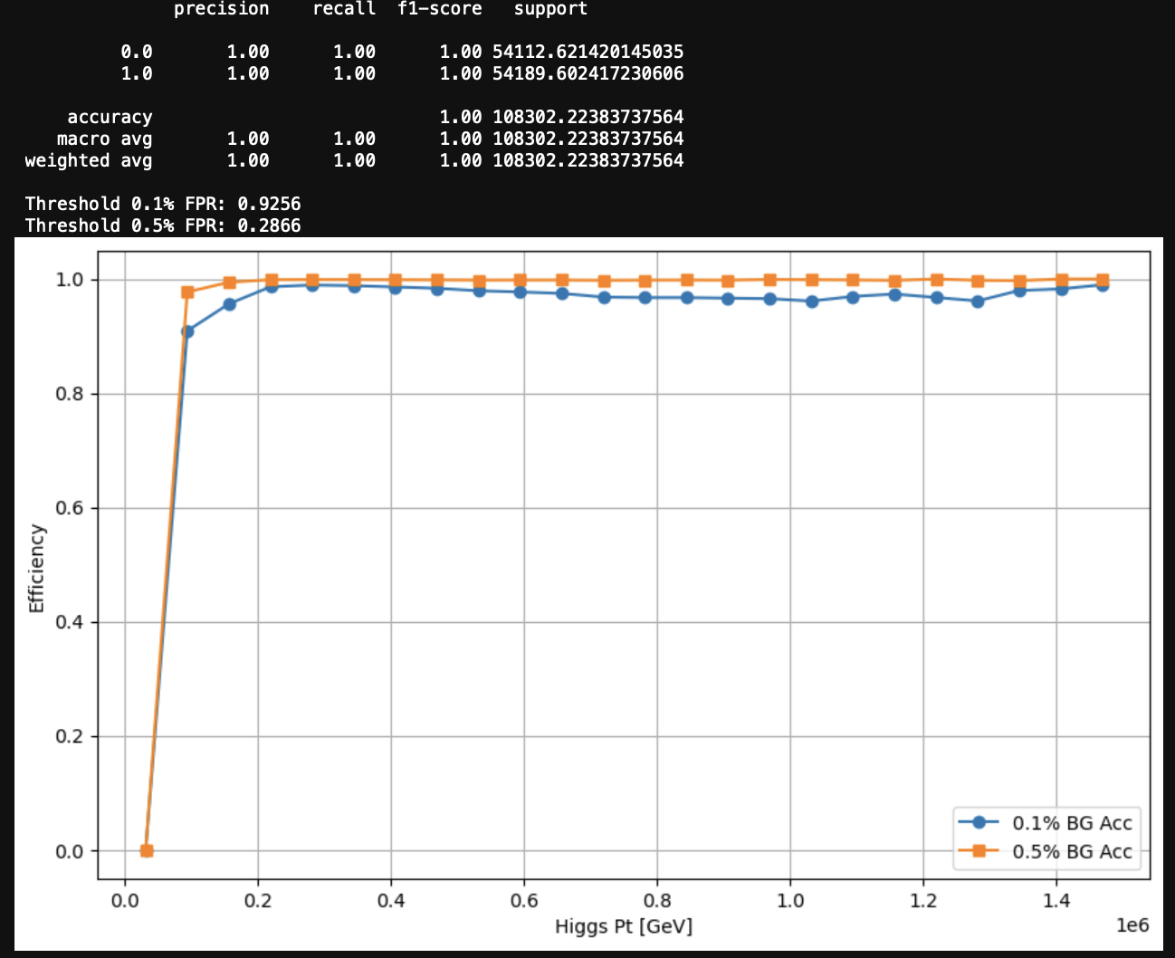

Slide 7
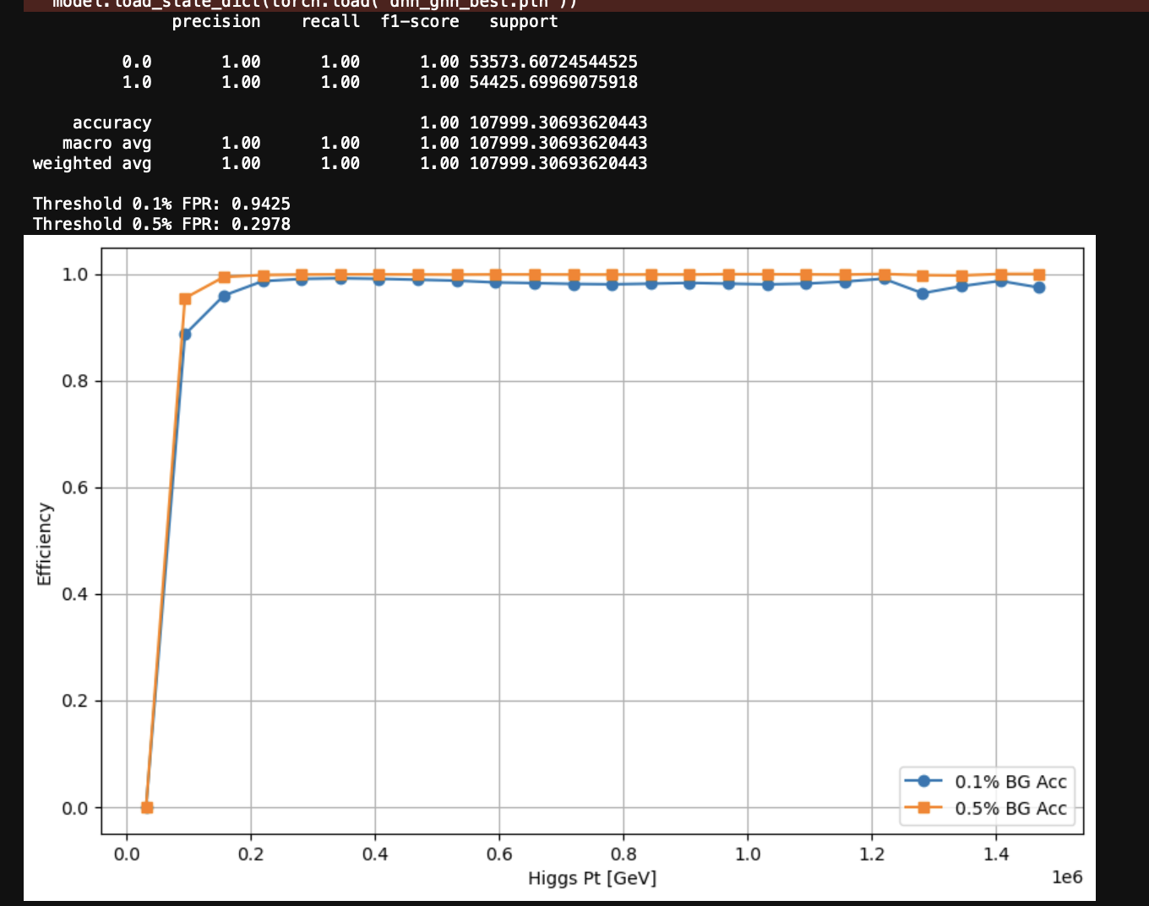
DNN All:

Slide 8

Merged

